Slide 1
CS663/362 Artificial Intelligence Lab Assignment 10 Group Ascent
Group Members:
Adarsh Shukla (202051008)
Aman Anand (202051019)
Arun Kumar Gupta (202051035)
Kalash Singh Jadoun (202051097)

Slide 2
Learning Objective: Understand the process of sequential decision making (stochastic environment) and the connection with reinforcement learning Title: Markov Decision Process and Dynamic Programming

Slide 3
Markov Decision Process
An MDP consists of a set of states, a set of actions, and a set of probabilities that describe the outcomes of actions taken in each state. The state of the system is assumed to evolve according to a Markov process, which means that the future state depends only on the current state and the action taken, and not on the past history of the system.

Slide 4

Bellman Equation
Here, U(s) represents the value of state s, a is an action, s' represents the next state, P(s'|s,a) is the probability of transitioning to state s' from state s when action a is taken, R(s,a,s') is the reward received from transitioning from state s to state s' when action a is taken, and γ is a discount factor that represents the importance of future rewards.

Slide 5
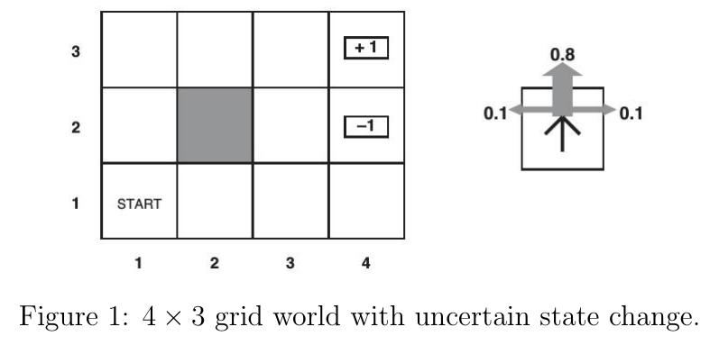
Problem 1
Suppose that an agent is situated in the 4x3 environment as shown in Figure 1. Beginning in the start state, it must choose an action at each time step. The interaction with the environment terminates when the agent reaches one of the goal states, marked +1 or -1. We assume that the environment is fully observable, so that the agent always knows where it is. You may decide to take the following four actions in every state: Up, Down, Left and Right. However, the environment is stochastic, that means the action that you take may not lead you to the desired state. Each action achieves the intended effect with probability 0.8, but the rest of the time, the action moves the agent at right angles to the intended direction with equal probabilities. Furthermore, if the agent bumps into a wall, it stays in the same square. The immediate reward for moving to any state (s) except for the terminal states S⁺ is r(s)= -0.04. And the reward for moving to terminal states is +1 and -1 respectively. Find the value function corresponding to the optimal policy using value iteration.
Find the value functions corresponding optimal policy for the following:
r(s)=-2
r(s)=0.1
r(s)=0.02
r(s)=1

Slide 6
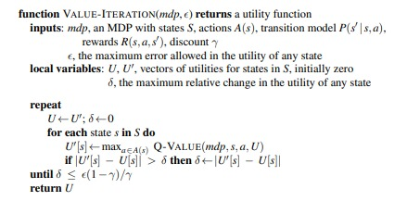

Algorithm of value iteration

Slide 7
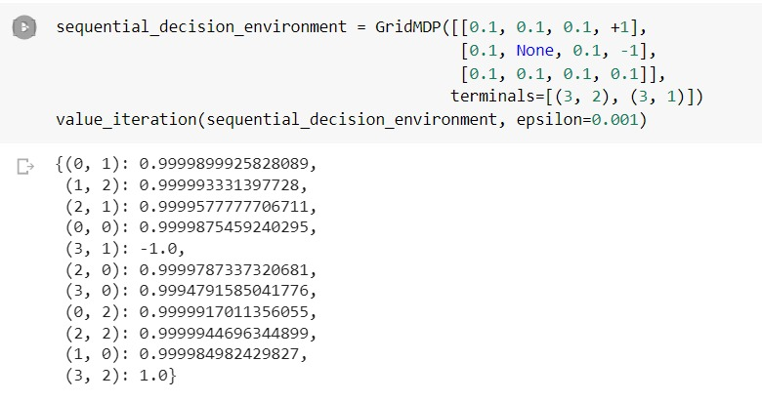
This is the result of code with the reward value = 0.1

Slide 8
Problem 2:
[Gbike bicycle rental] You are managing two locations for Gbike. Each day, some number of customers arrive at each location to rent bicycles. If you have a bike available, you rent it out and earn INR 10 from Gbike. If you are out of bikes at that location, then the business is lost. Bikes become available for renting the day after they are returned. To help ensure that bicycles are available where they are needed, you can move them between the two locations overnight, at a cost of INR 2 per bike moved.
Assumptions: Assume that the number of bikes requested and returned at each location are Poisson random variables. Expected numbers of rental requests are 3 and 4 and returns are 3 and 2 at the first and second locations respectively. No more than 20 bikes can be parked at either of the locations. You may move a maximum of 5 bikes from one location to the other in one night. Consider the discount rate to be 0.9.
Formulate the continuing finite MDP, where time steps are days, the state is the number of bikes at each location at the end of the day, and the actions are the net number of bikes moved between the two locations overnight.

Slide 9
Problem 3
Write a program for policy iteration and resolve the Gbike bicycle rental problem with the following changes. One of your employees at the first location rides a bus home each night and lives near the second location. She is happy to shuttle one bike to the second location for free. Each additional bike still costs INR 2, as do all bikes moved in the other direction. In addition, you have limited parking space at each location. If more than 10 bikes are kept overnight at a location (after any moving of cars), then an additional cost of INR 4 must be incurred to use a second parking lot (independent of how many cars are kept there).

Slide 10
Policy Iteration
Policy Iteration is an algorithm in ‘Reinforcement Learning', which helps in learning the optimal policy which maximizes the long term discounted reward. These techniques are often useful, when there are multiple options to chose from, and each option has its own rewards and risks.

Slide 11
We can then use policy iteration to determine the optimal policy. The algorithm involves the following steps:
Initialize the policy arbitrarily
Evaluate the policy by calculating the value function for each state under the current policy
Improve the policy by updating the policy based on the current value function
Repeat steps 2 and 3 until the policy converges to the optimal policy

Slide 12
We used the
‘transition_probs’ function -> calculate the transition probabilities and rewards for a given state and action.
‘policy_evaluation’ function updates the value function for a given policy, and ‘policy_improvement’ function updates the policy for a given value function.
We run the policy iteration loop until convergence, where convergence is achieved when the policy is stable and no longer changes. Finally, we print out the optimal policy and value function.
Note that we use the Poisson distribution with a parameter of 3 (4) for the first (second) location to model the number of rentals at each location, as specified in the original problem description. We also check for parking costs by subtracting the cost from the reward when the number of bikes at a location is greater than 10.

Slide 13
References
Artificial Intelligence a Modern Approach, Russell and Norvig (third edition) Chapter 16, 17, 21
Reinforcement Learning, Sutton and Barto (second edition)
Chapter 3, 4

